Slide 1
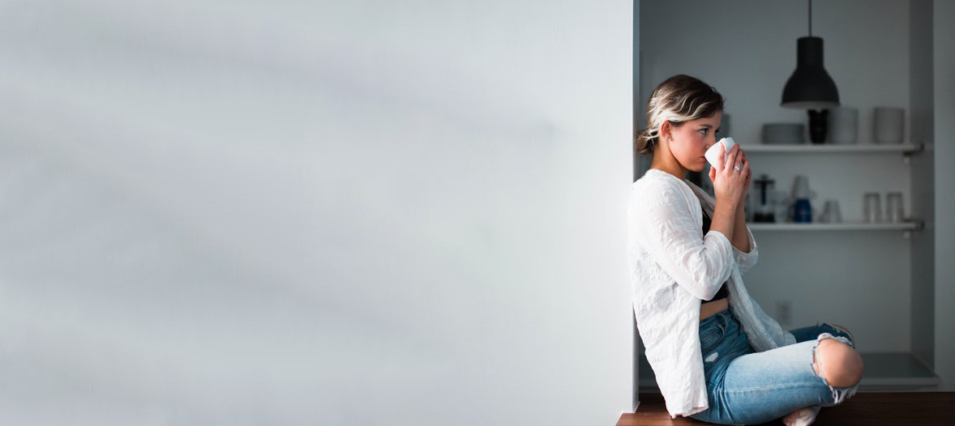
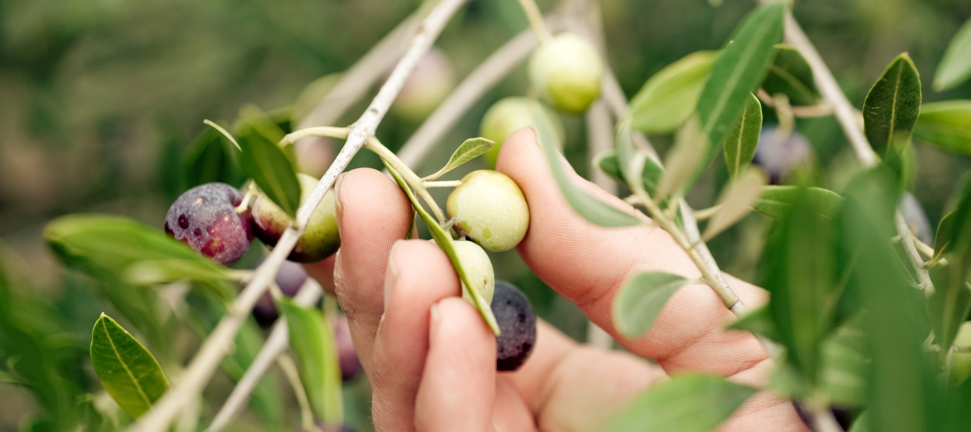
Maison de Thé
SCANDI- LIFESTYLE TEA
WWW.MAISONDETHE.CO.UK

Slide 2
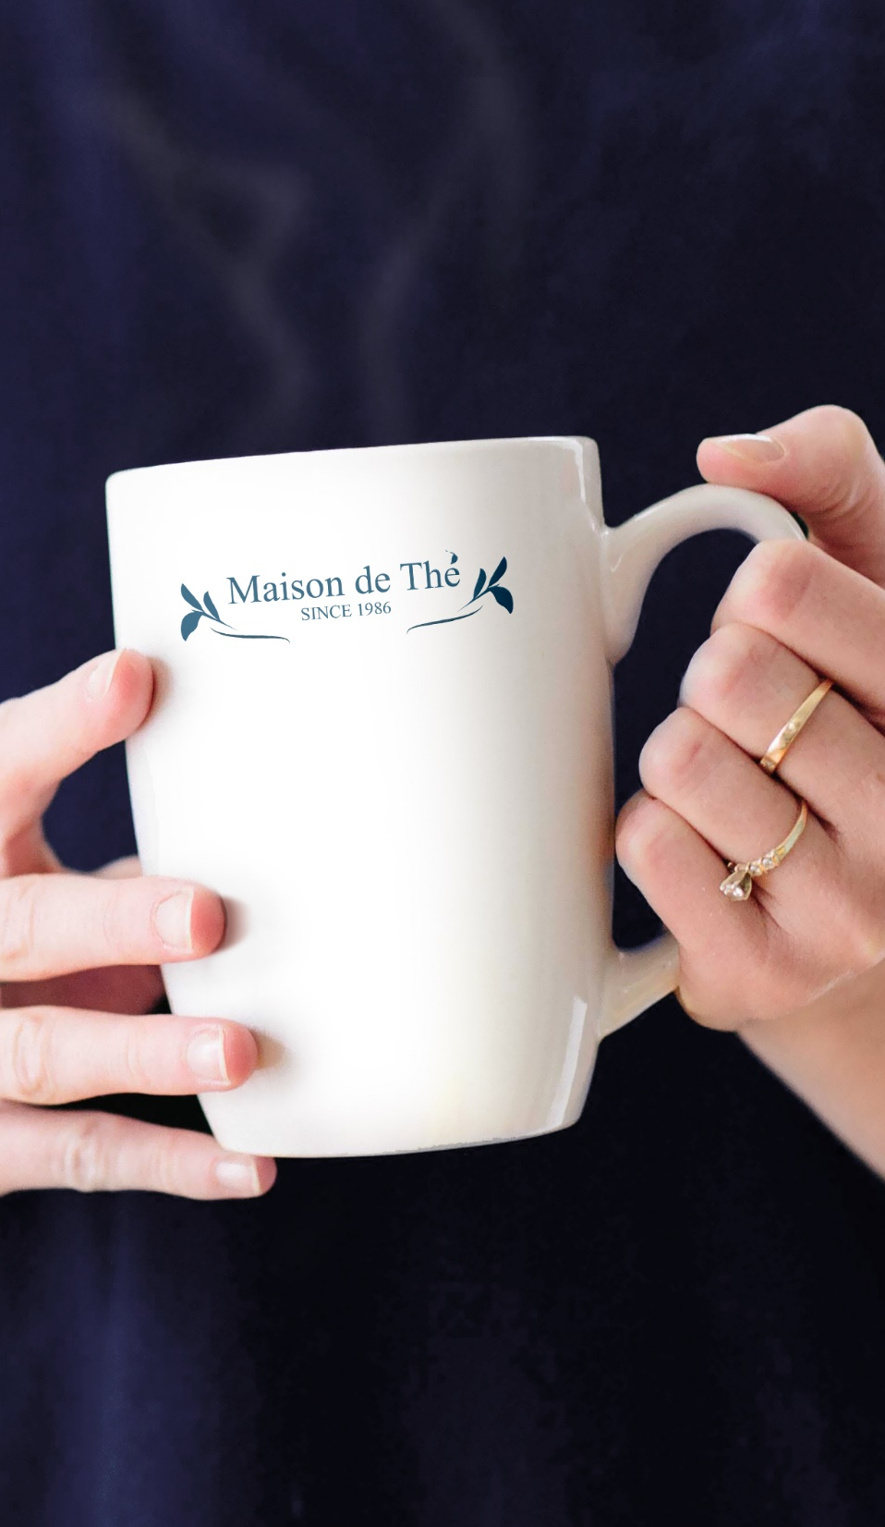
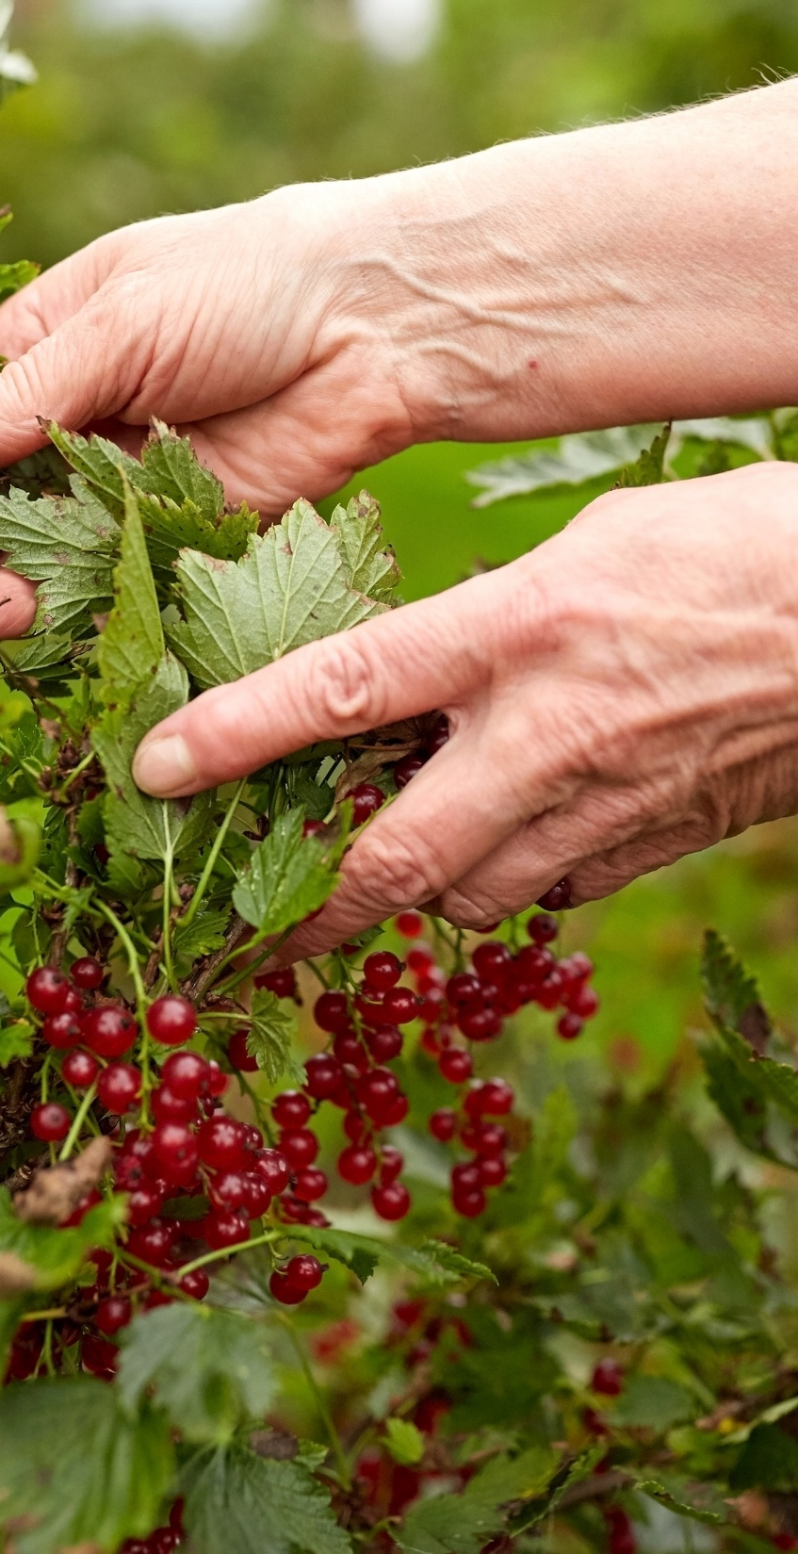
STORY
ABOUT US
Relax and have a cuppa just like being at home
Maison de Thé was named by “The home of tea” in French. We‘d like to create a space of Scandinavian style to make you just like have a cup of tea at home.
WWW.MAISONDETHE.CO.UK

Slide 3
關於色彩
以北歐風格配色藍與灰為主，搭配最存粹的白色營造出舒適感，讓人不論在何時何地喝茶也能像在家一樣放鬆，這六種顏色一看便可以感受到以“Normal”一詞所衍伸出的自然，不造作感覺的簡約北歐風概念。
北歐沈靜藍
黎明冰川灰
冰島午夜藍湖
瑞典日光格調
花崗岩灰
雪地白
# 255B7A
# E0E0E0
# 78909C
# B5BCC2
# CFD4D7
# FFF

Slide 4
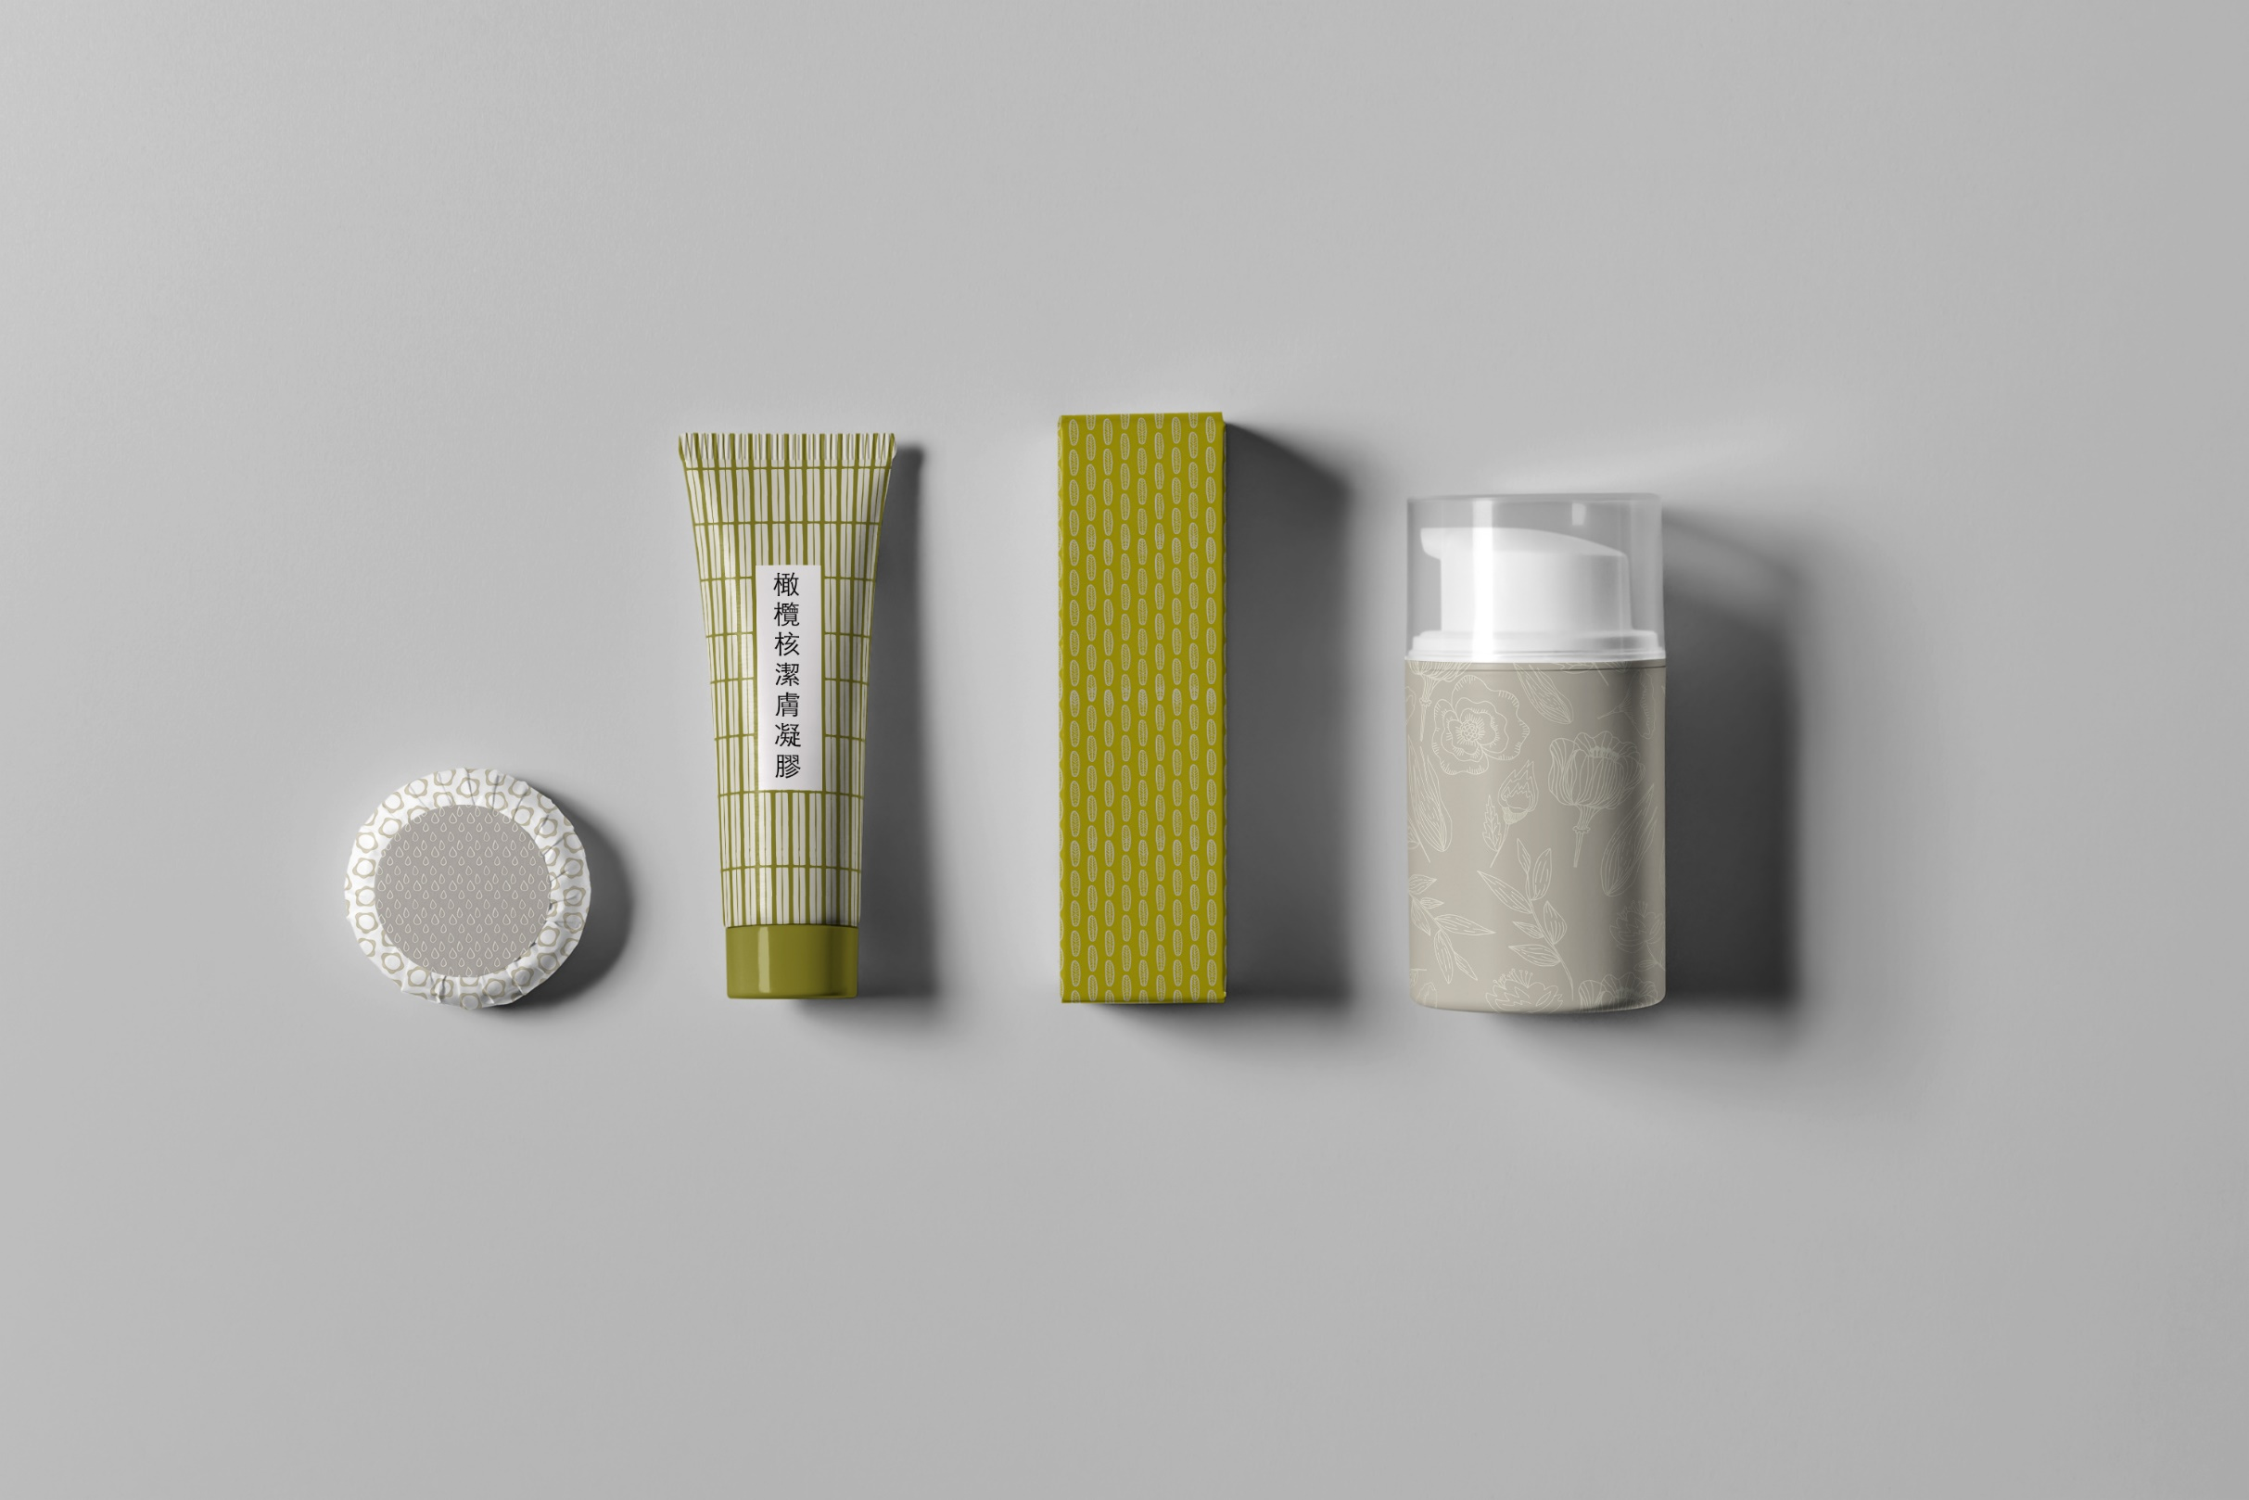
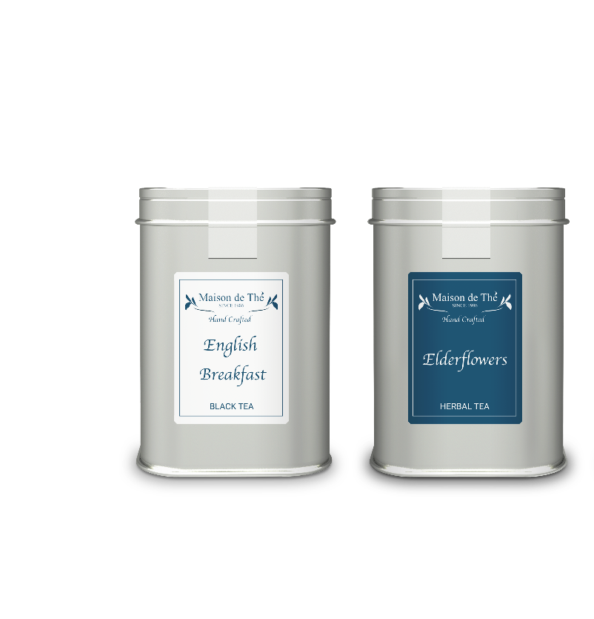
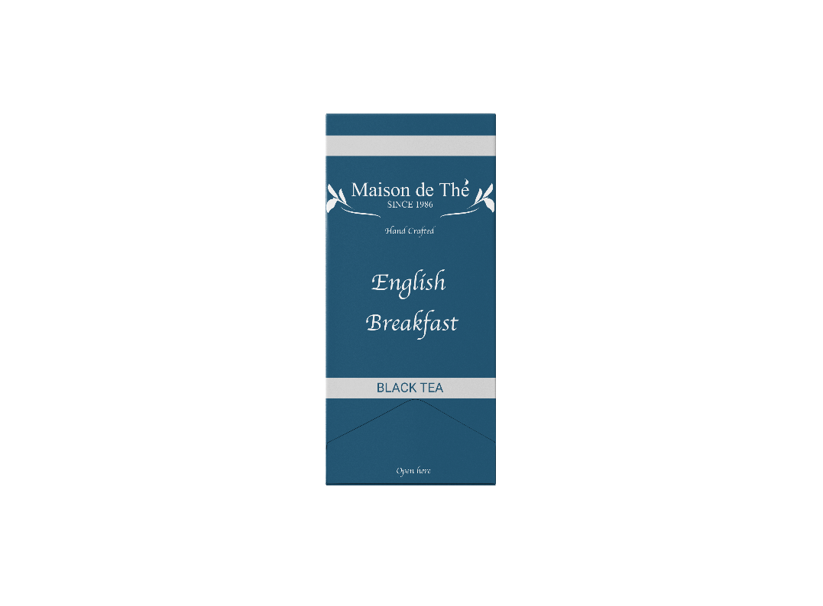
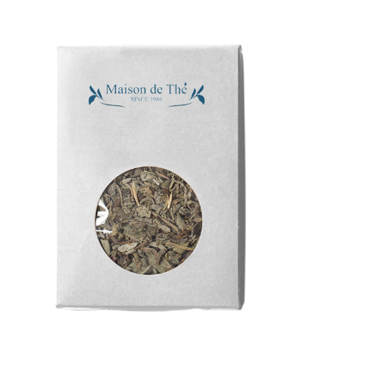
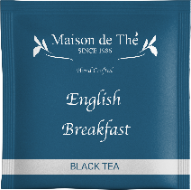
MAISON DE THÉ
SCANDI- LIFESTYLE TEA
MAISONDETHE.CO.UK

Slide 5
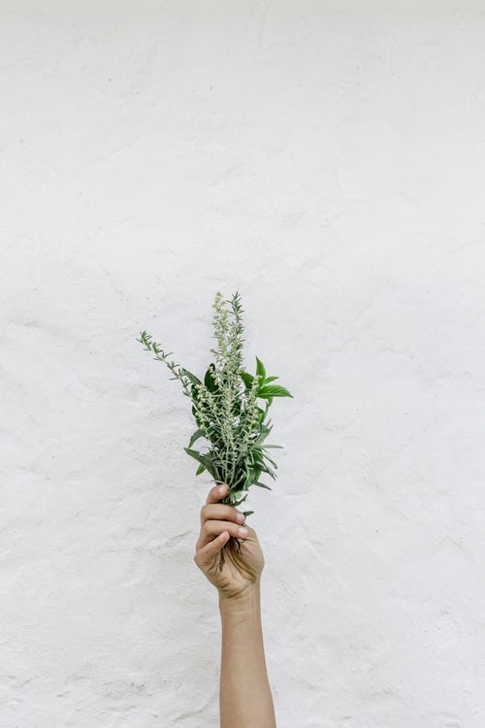
Our Products
Relax and have a cuppa just like being at home
Maison de Thé has multiple products in store from wrapped tea bags pack to tea tin giftpack all you can choose.
1
PURE INGREDIENT
WWW.MAISONDETHE.CO.UK
Maison de Thé develops blended teas by Natural ingredients
2
CREATIVE
Maison de Thé innovates various types of blended tea, herbal & fruits tea with multiple ingredients
3
TAKEAWAY
Maison de Thé also provides convenient takeaway path

Slide 6
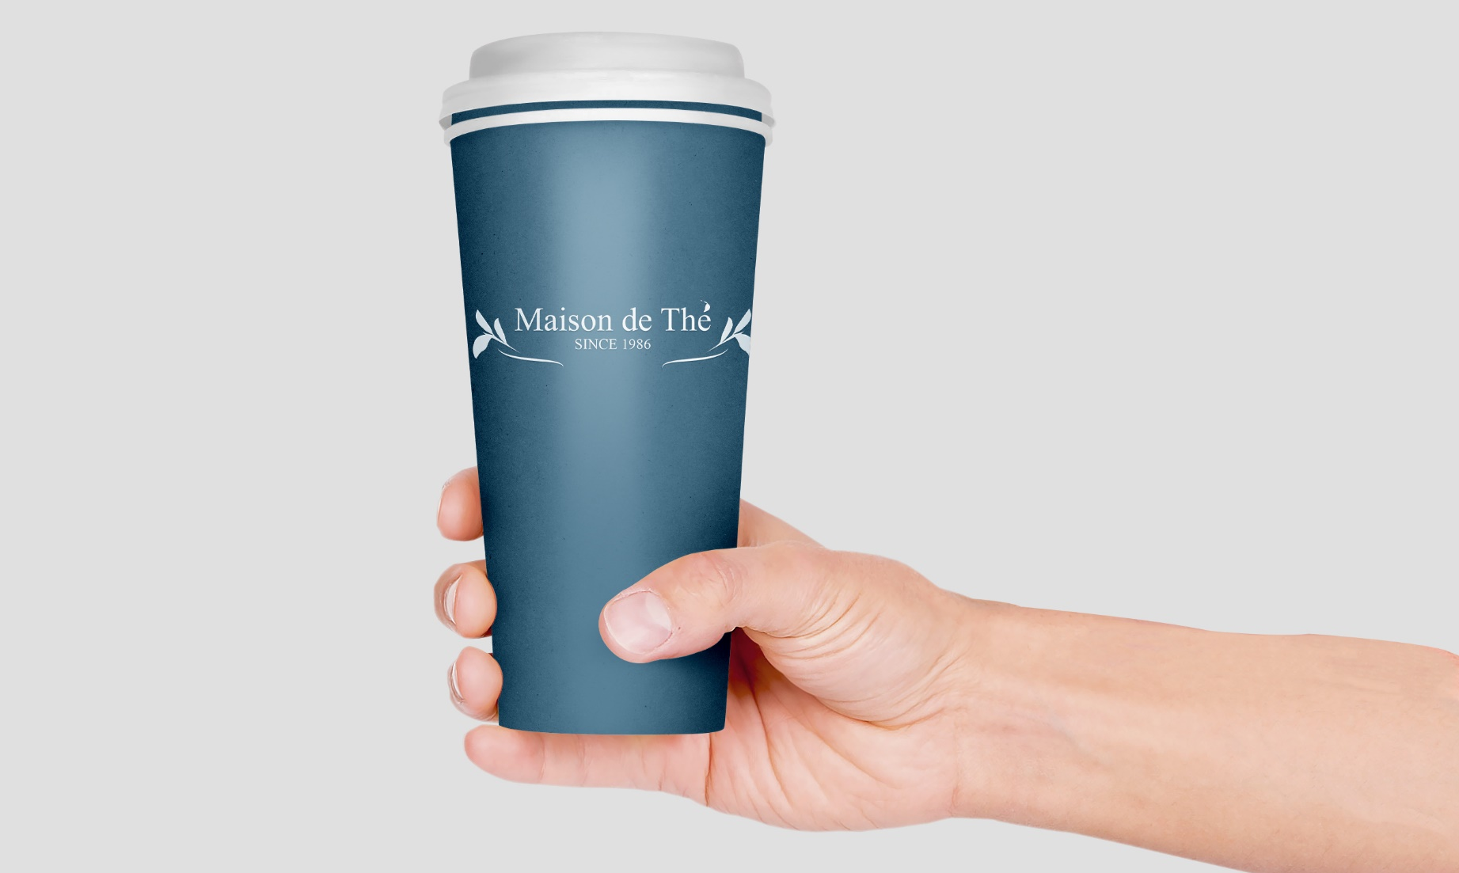
OUR TAKEAWAY
TEA
Relax and have a cuppa just like being at home
Maison de Thé provides various options of tea on our takeaway menu.
We’d like our customers feel like being at homes anywhere & anytime.
Blended, black, green & herbal tea all items are served.

Slide 7
Find Our
Brick Store
Find Our Products
Relax and have a cuppa just like being at home
Relax and have a cuppa just like being at home
Except the online store. Our products can be found at Waitrose & M&S
We also have the only brick store in Sussex.
OUR LOCATION : 112 Henley Road Sussex PA78 9PT U.K.
CONTACT US : +44 79 0739 3111
WEBSITE : WWW.MAISONDETHE.CO.UK

Slide 8

WWW. MAISONDETHE.CO.UK

